Slide 1
Trees
Chapter 11
Copyright © McGraw-Hill Education. All rights reserved. No reproduction or distribution without the prior written consent of McGraw-Hill Education.

Slide 2
Chapter Summary
Introduction to Trees
Applications of Trees (not currently included in overheads)
Tree Traversal
Spanning Trees
Minimum Spanning Trees (not currently included in overheads)

Slide 3
Introduction to Trees
Section 11.1

Slide 4
Section Summary
Introduction to Trees
Rooted Trees
Properties of Trees

Slide 5
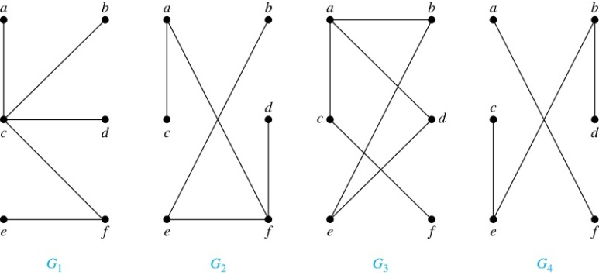
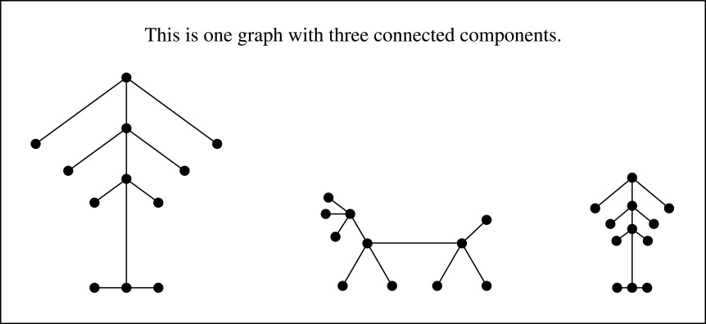
Trees
Definition: A tree is a connected undirected graph with no simple circuits.
Example: Which of these graphs are trees?
Solution: G₁ and G₂ are trees - both are connected and have no simple circuits. Because e, b, a, d, e is a simple circuit, G₃ is not a tree. G₄ is not a tree because it is not connected.
Definition: A forest is a graph that has no simple circuit, but is not connected. Each of the connected components in a forest is a tree.

Slide 6
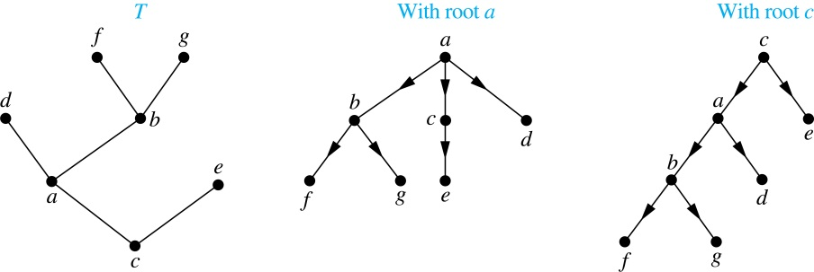
Rooted Trees
Definition: A rooted tree is a tree in which one vertex has been designated as the root and every edge is directed away from the root.
An unrooted tree is converted into different rooted trees when different vertices are chosen as the root.

Slide 7
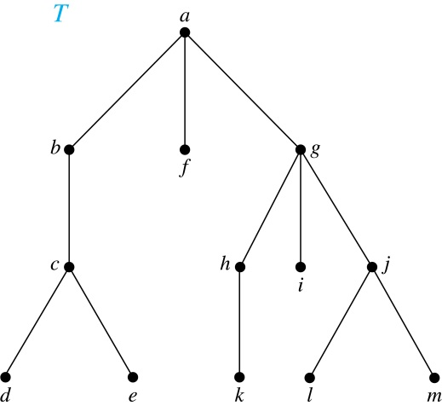
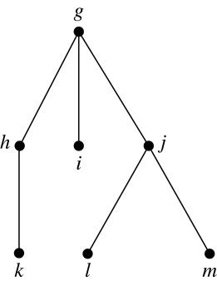
Terminology for Rooted Trees
Example: In the rooted tree T (with root a):
Find the parent of c, the children of g, the siblings of h, the ancestors of e, and the descendants of b.
Find all internal vertices and all leaves.
What is the subtree rooted at G?
Solution:
The parent of c is b. The children of g are h, i, and j. The siblings of h are i and j. The ancestors of e are c, b, and a. The descendants of b are c, d, and e.
The internal vertices are a, b, c, g, h, and j. The leaves are d, e, f, i, k, l, and m.
We display the subtree rooted at g.

Slide 8
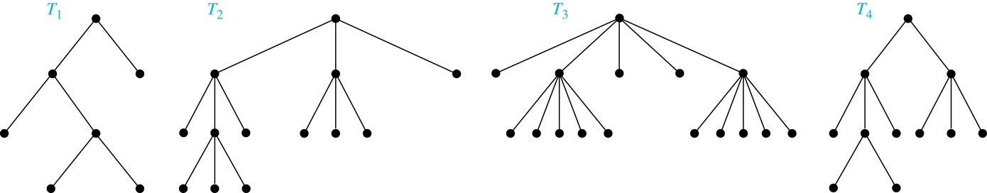
m-ary Rooted Trees
Definition: A rooted tree is called an m-ary tree if every internal vertex has no more than m children. The tree is called a full m-ary tree if every internal vertex has exactly m children. An m-ary tree with m = 2 is called a binary tree.
Example: Are the following rooted trees full m-ary trees for some positive integer m?
Solution: T₁ is a full binary tree because each of its internal vertices has two children. T₂ is a full 3-ary tree because each of its internal vertices has three children. In T₃ each internal vertex has five children, so T₃ is a full 5-ary tree. T₄ is not a full m-ary tree for any m because some of its internal vertices have two children and others have three children.

Slide 9
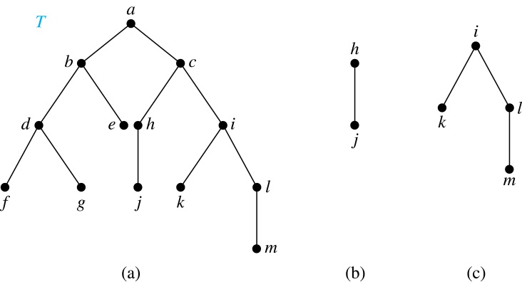
Ordered Rooted Trees
Definition: An ordered rooted tree is a rooted tree where the children of each internal vertex are ordered.
We draw ordered rooted trees so that the children of each internal vertex are shown in order from left to right.
Definition: A binary tree is an ordered rooted where where each internal vertex has at most two children. If an internal vertex of a binary tree has two children, the first is called the left child and the second the right child. The tree rooted at the left child of a vertex is called the left subtree of this vertex, and the tree rooted at the right child of a vertex is called the right subtree of this vertex.
Example: Consider the binary tree T.
(i) What are the left and right children of d?
(ii) What are the left and right subtrees of c?
Solution:
(i) The left child of d is f and the right child is g.
(ii) The left and right subtrees of c are displayed in
(b) and (c).

Slide 10
Counting Vertices in Full m-Ary Trees
A tree with n vertices has n − 1 edges.
A full m-ary tree with
(i)
(ii)
(iii)
n vertices has i = (n − 1)/m internal vertices and l = [(m − 1)n + 1]/m leaves,
i internal vertices has n = mi + 1 vertices and l = (m − 1)i + 1 leaves,
l leaves has n = (ml − 1)/(m − 1) vertices and i = (l − 1)/ (m − 1) internal vertices.

Slide 11
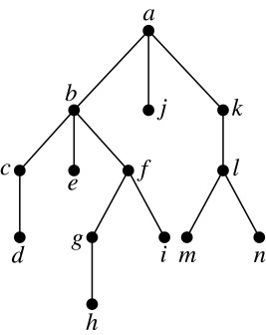
Level of vertices and height of trees
When working with trees, we often want to have rooted trees where the subtrees at each vertex contain paths of approximately the same length.
To make this idea precise we need some definitions:
The level of a vertex v in a rooted tree is the length of the unique path from the root to this vertex.
The height of a rooted tree is the maximum of the levels of the vertices.
Example:
(i) Find the level of each vertex in
the tree to the right.
(ii) What is the height of the tree?
Solution:
(i) The root a is at level 0. Vertices b, j, and k are at level 1.
Vertices c, e, f, and l are at level 2. Vertices d, g, i, m, and n are at level 3.
Vertex h is at level 4.
(ii) The height is 4, since 4 is the largest level of any vertex.

Slide 12
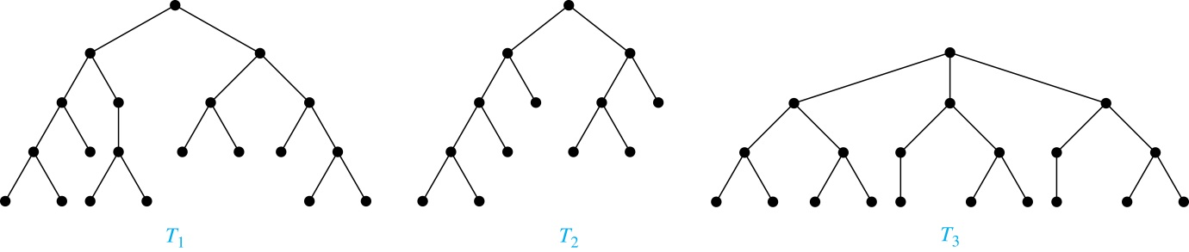
Balanced m-Ary Trees
Definition: A rooted m-ary tree of height h is balanced if all leaves are at levels h or h − 1.
Example: Which of the rooted trees shown below is balanced?
Solution: T₁ and T₃ are balanced, but T₂ is not because it has leaves at levels 2, 3, and 4.

Slide 13
Tree Traversal
Section 11.3

Slide 14
Section Summary
Universal Address Systems (not currently included in overheads)
Traversal Algorithms
Infix, Prefix, and Postfix Notation

Slide 15
Tree Traversal
Procedures for systematically visiting every vertex of an ordered tree are called traversals.
The three most commonly used traversals are preorder traversal, inorder traversal, and postorder traversal.

Slide 16
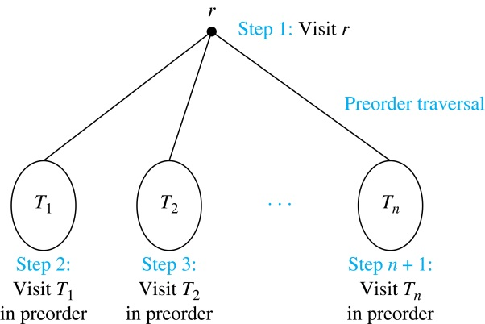
Preorder Traversal
Definition: Let T be an ordered rooted tree with root r. If T consists only of r, then r is the preorder traversal of T. Otherwise, suppose that T₁, T₂, …, T_{n} are the subtrees of r from left to right in T. The preorder traversal begins by visiting r, and continues by traversing T₁ in preorder, then T₂ in preorder, and so on, until T_{n} is traversed in preorder.

Slide 17
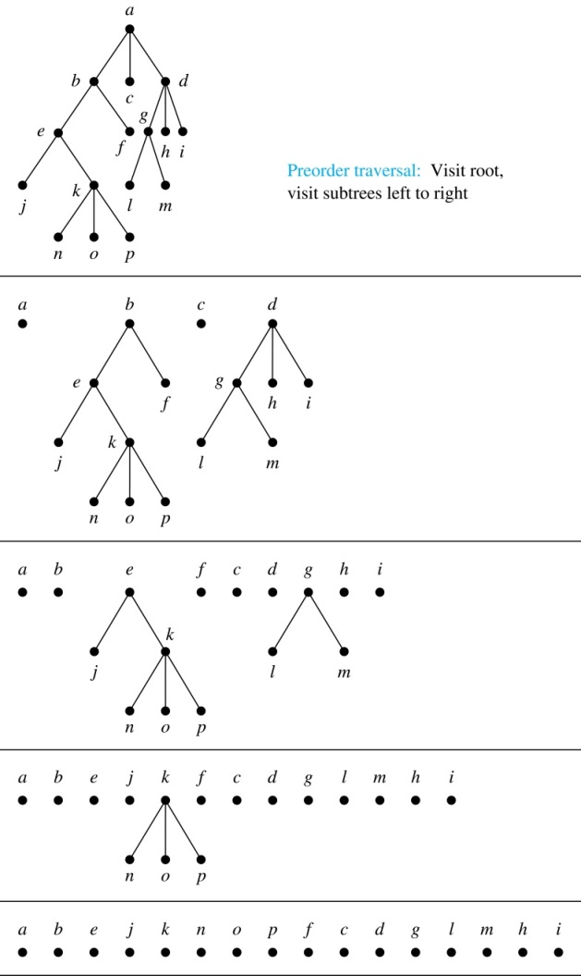
Preorder Traversal (continued)
procedure preorder (T: ordered rooted tree)
r := root of T
list r
for each child c of r from left to right
T(c) := subtree with c as root
preorder(T(c))

Slide 18
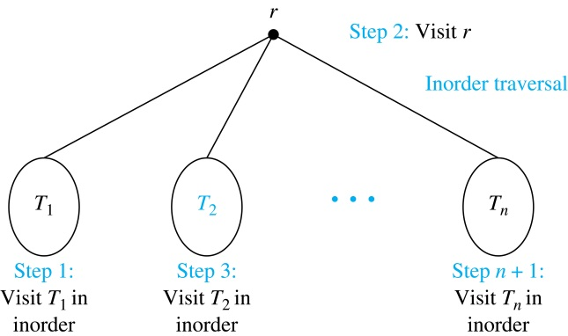
Inorder Traversal
Definition: Let T be an ordered rooted tree with root r. If T consists only of r, then r is the inorder traversal of T. Otherwise, suppose that T₁, T₂, …, T_{n} are the subtrees of r from left to right in T. The inorder traversal begins by traversing T₁ in inorder, then visiting r, and continues by traversing T₂ in inorder, and so on, until T_{n} is traversed in inorder.

Slide 19
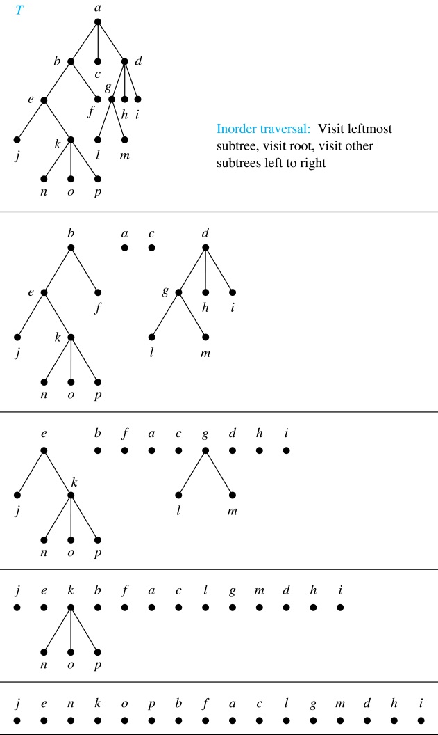
Inorder Traversal (continued)
procedure inorder (T: ordered rooted tree)
r := root of T
if r is a leaf then list r
else
l := first child of r from left to right
T(l) := subtree with l as its root
inorder(T(l))
list(r)
for each child c of r from left to right
T(c) := subtree with c as root
inorder(T(c))

Slide 20
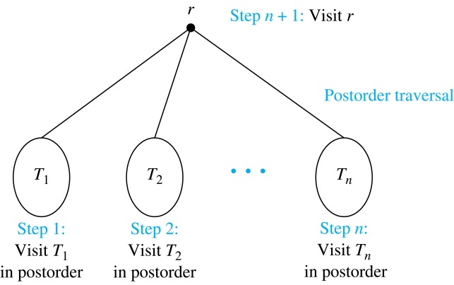
Postorder Traversal
Definition: Let T be an ordered rooted tree with root r. If T consists only of r, then r is the postorder traversal of T. Otherwise, suppose that T₁, T₂, …, T_{n} are the subtrees of r from left to right in T. The postorder traversal begins by traversing T₁ in postorder, then T₂ in postorder, and so on, after T_{n} is traversed in postorder, r is visited.

Slide 21
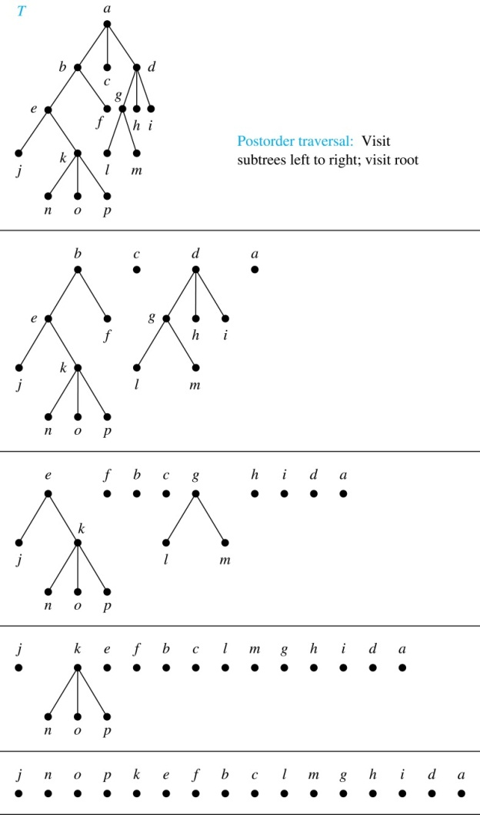
Postorder Traversal (continued)
procedure postordered (T: ordered rooted tree)
r := root of T
for each child c of r from left to right
T(c) := subtree with c as root
postorder(T(c))
list r

Slide 22
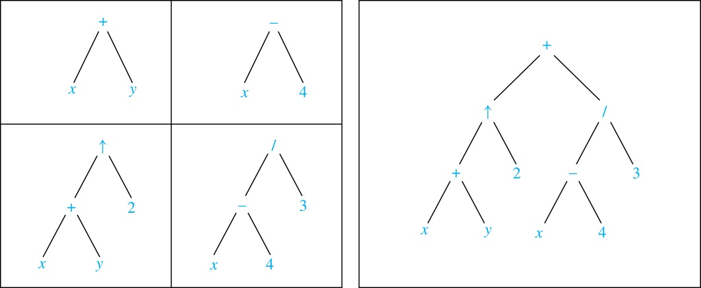
Expression Trees
Complex expressions can be represented using ordered rooted trees.
Consider the expression ((x + y) ↑ 2 ) + ((x − 4)/3).
A binary tree for the expression can be built from the bottom up, as is illustrated here.

Slide 23
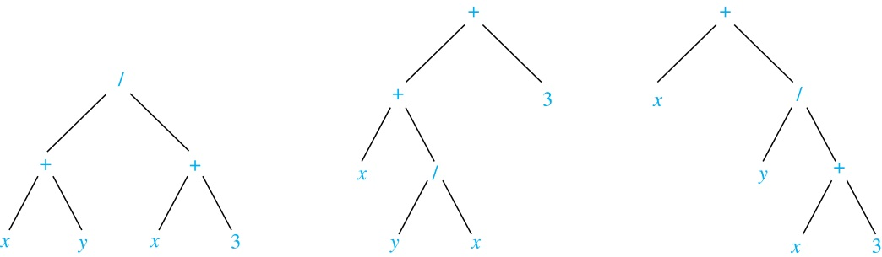
Infix Notation
An inorder traversal of the tree representing an expression produces the original expression when parentheses are included except for unary operations, which now immediately follow their operands.
We illustrate why parentheses are needed with an example that displays three trees all yield the same infix representation.

Slide 24
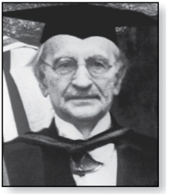
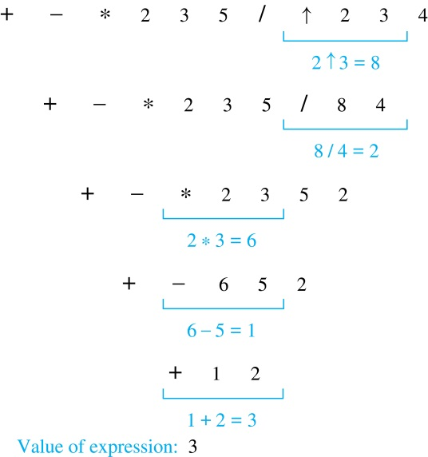
Prefix Notation
Jan Łukasiewicz (1878-1956)
Example: We show the steps used to evaluate a particular prefix expression:
When we traverse the rooted tree representation of an expression in preorder, we obtain the prefix form of the expression. Expressions in prefix form are said to be in Polish notation, named after the Polish logician Jan Łukasiewicz.
Operators precede their operands in the prefix form of an expression. Parentheses are not needed as the representation is unambiguous.
The prefix form of ((x + y) ↑ 2 ) + ((x − 4)/3)
is + ↑ + x y 2 / − x 4 3.
Prefix expressions are evaluated by working from right to left. When we encounter an operator, we perform the corresponding operation with the two operations to the right.

Slide 25
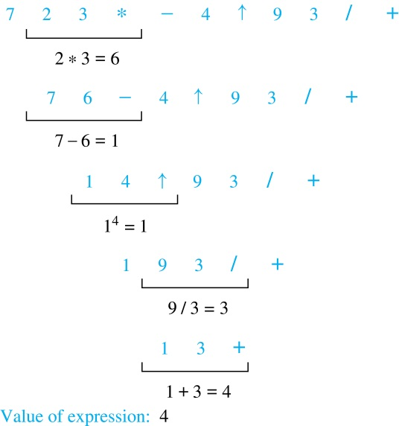
Postfix Notation
Example: We show the steps used to evaluate a particular postfix expression.
We obtain the postfix form of an expression by traversing its binary trees in postorder. Expressions written in postfix form are said to be in reverse Polish notation.
Parentheses are not needed as the postfix form is unambiguous.
x y + 2 ↑ x 4 − 3 / + is the postfix form of ((x + y) ↑ 2 ) + ((x − 4)/3).
A binary operator follows its two operands. So, to evaluate an expression one works from left to right, carrying out an operation represented by an operator on its preceding operands.

